Slide 1
The road to taxonomy-specific RPS-BLAST
Codeathon (10-16-2019)
Marc Gwadz
Christiam Camacho
Jianli Dai
Hanguan Liu
Jiyao Wang
Mingzhang Yang

Slide 2
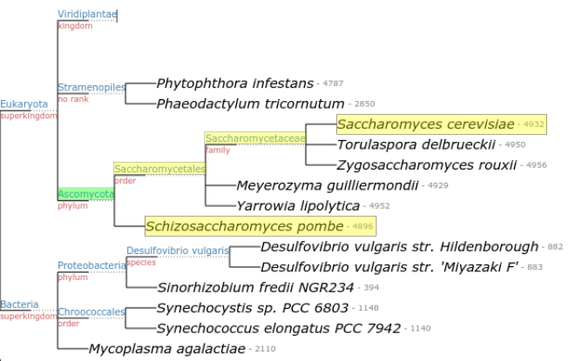
Goal
To assign taxonomy information to conserved protein domains

Slide 3
Detailed Goal
conserved domain → model → the lowest common taxonomic node → taxonomy ID
Use taxonomy information to limit an RPS-BLAST search

Slide 4
Workflow
IPG/Seq-ID | taxid | Taxonomy lineage
n | t | t1,t2,t3,…, tn
CDD
Model
Model
taxid
A database of protein models
Decompose the model in its parts:
Sequence IDs, their taxonomy IDs, and each of the taxonomy lineage for these

Slide 5
IPG-1
TaxID-1
IPG-2
Root
Domain-1
TaxID-2
IPG-3
IPG-4
TaxID-3
TaxID Domain-1
TaxID-1
TaxID-4
Domain-2
IPG-5
TaxID-4
.
.
.
.
.
.
.
.
.
TaxID-2
TaxID-3
Domain-l
IPG-n
TaxID-m

Slide 6
Outline
Extract taxonomy IDs for each model
Extract each taxID’s lineage
Build a model specific subset of the taxonomy tree with relevant taxIDs
Assign a weight to each node
Find the lowest common ancestor that meets a threshold (e.g.: 95% of all taxIDs are under that node)

Slide 7
Find the lowest common tax. node
Tax lineage-----------------------------------------------------------------------------------------------------→
taxid | root | ??? | ??? | ??? | ??? | ??? | ??? | ???
taxid1 | x | x | x | x | x | x | x
taxid2 | x | x | x | x | x
taxid3 | x | x | x | x | x | x
taxid4 | x | x | x | x
taxid5 | x | x | x | x

Slide 8
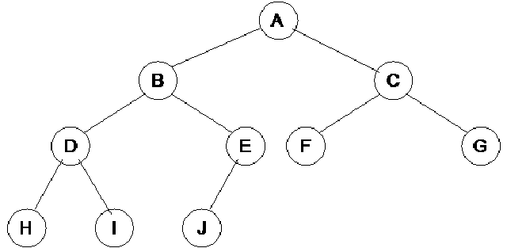

Slide 9
Programming language:
Python

